Slide 1
The Paul-Elder Method for Critical Thinking
Kim Baker
Sociology, Anthropology, & Criminology
kimberly.baker@uni.edu

Slide 2
Didactic Teaching = Passive Students
Focus on memorizing and regurgitating
Teachers as dispensers of knowledge.
Expect that questions on the test should only come from material covered in class
Expect problems assigned in class to be clearly formulated
Believe that there is an adequate answer for every question
View conclusions as simply a matter of opinion

Slide 3
Challenges
The more work we do, the less work they do.
Place students at the center of learning.

Slide 4
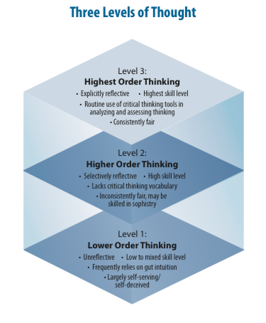
p. 7

Slide 5
The Paul-Elder Method
Elements of Thought
Standards of Evaluation
Intellectual Traits

Slide 6
p. 3

Slide 7
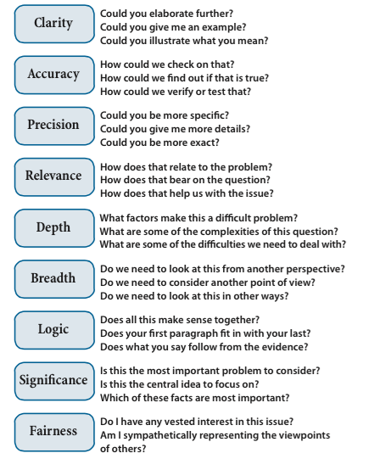
p. 10

Slide 8
p. 13

Slide 9
p. 19

Slide 11
Sociology of Violence
Purpose: To understand violence as a social phenomenon; it’s causes and impact
Question: Where does violence come from? How do we stop it?
Key Concepts: Interpersonal violence, family violence, rape, oppression, hate, anger, inequality
Assumptions: Violence is bad; If we understand violence, we can stop/reduce it

Slide 12
SEEI
State
Brief, clear, and precise summary in your own words
Elaborate
Provide more depth, greater detail
Exemplify
Clarify using an example
Illustrate
Paint a picture using a simile, metaphor, or analogy

Slide 13
SEEI – Pro Se Defense
State – Criminal defendants represent themselves in court rather than hire an attorney.
Elaborate – attractive to some marginalized defendants
Mentally ill – see their attorney as compromised
Poor – unable to hire counsel and believe that they can dedicate the time and effort necessary to win their case
Exemplify
Scott Panetti – from competency video
Illustrate
It’s like being hungry, but instead of going to the grocery store you decide to go fishing. It may sound like a good idea, but you have to have the equipment and knowledge to fish successfully and there’s always a chance that even when you catch a fish is is not a good one (too small, sick, etc.)

Slide 14
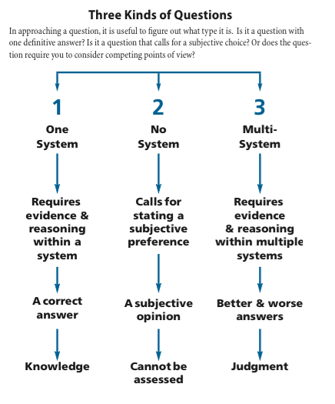
Asking Good Questions
p. 16

Slide 15
CQEP
Context: What are you noticing?
Question: What question does the topic raise for you?
Elaboration: How could you explain your question further?
Purpose: What can be gained from answering this question?

Slide 16
Final Comments
Start small & adapt
Learning is a process
Value unclear instructions
Learning through frustration
Let students make mistakes and work through them
The more work we do, the less work they do

Slide 17
Additional Resources
http://criticalthinking.org
Analytic Thinking (for students)
https://www.youtube.com/user/GaryMeegan/videos

